Slide 1
Lecture 6 of 13
15th March Tuesday 2016
Flow of genetic information:
Three aspects -
Transcription, Translation
&
Genetic code

Slide 2
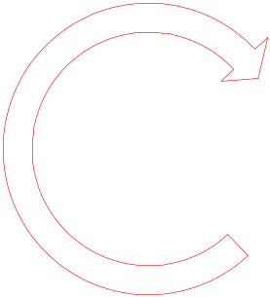


Central dogma of Molecular biology
सिद्धांत
RECAP
Nature of information flow
Flow of information Nucleic acid to protein
Flow of information: nucleic acid to nucleic acid
Replication
Transcription
Translation
DNA
RNA
protein
Reverse transcription
Why there is no loss of information during replication?
We will now explore this flow of information: that is, process of decoding the genetic message
How much of the information in DNA goes to RNA??

Slide 3
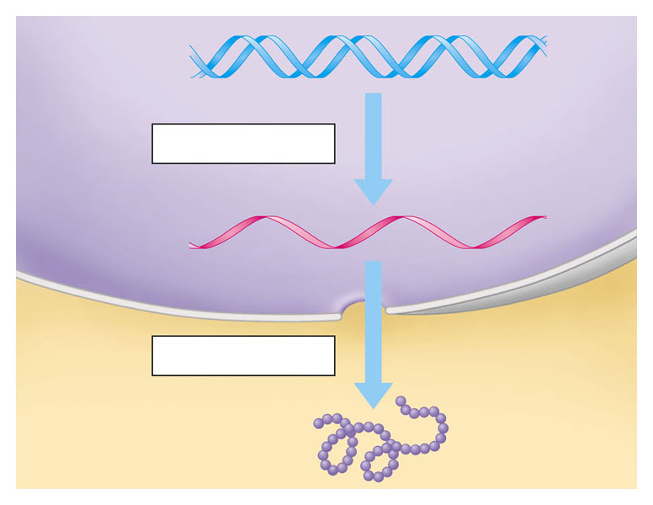
  Flow of genetic information
  A gene is transcribed into RNA
  which is then translated into the polypeptide
DNA
Transcription
RNA
Translation
Protein

Slide 4
FLOW OF GENETIC INFORMATION FROM DNA TO RNA TO PROTEIN
Gene (DNA) is a linear sequence of many nucleotides
  DNA is transcribed into a linear sequence of RNA
  RNA is translated into a linear sequence of amino acids – polypeptides (protein)
DNA
RNA
Protein
(polypeptide chain
Entire business of flow of genetic information thus depends on constructing (transferring information) one kind of polymer from another

Slide 5
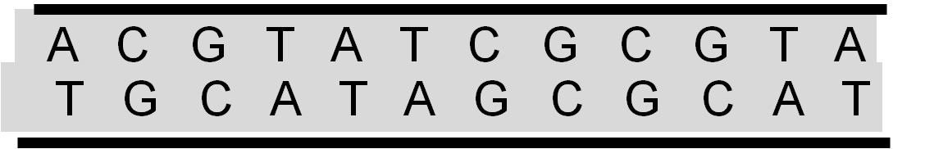
Transcription – Step I
T G C A T A G C G C A T
Template DNA Strands unzip locally

Slide 6
Transcription – Step II
A C G T A T C G C G T A
DNA
U G C A U A G C G C A U
mRNA
One of the DNA strands serve as a template and copied as mRNA (messenger RNA)

Slide 7
A C G T A T C G C G T A
DNA
T G C A T A G C G C A T
RNA
U G C A U A G C G C A U
mRNA is then releases

Slide 8
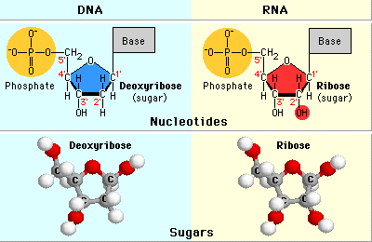
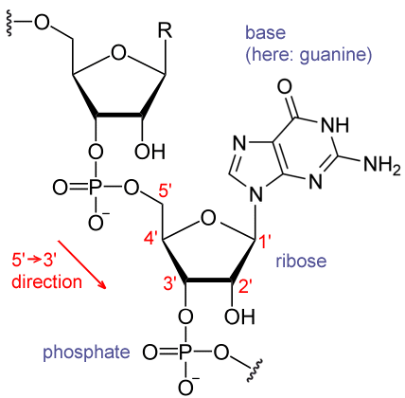
Notice the difference between ribose and deoxyribose in the figure above. In ribose, carbon atom #2 carries one hydroxyl group (colored red). In deoxyribose, carbon atom #2 carries a hyrogen atom instead of a hydroxyl group.
Chemical structure of RNA

Slide 9
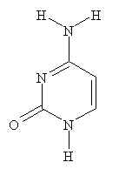
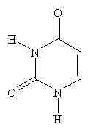
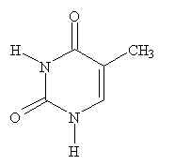
In place of thymine in DNA
Cytosine
Thymine
Uracil
DNA/RNA
DNA
RNA
Pyrimidine bases

Slide 10
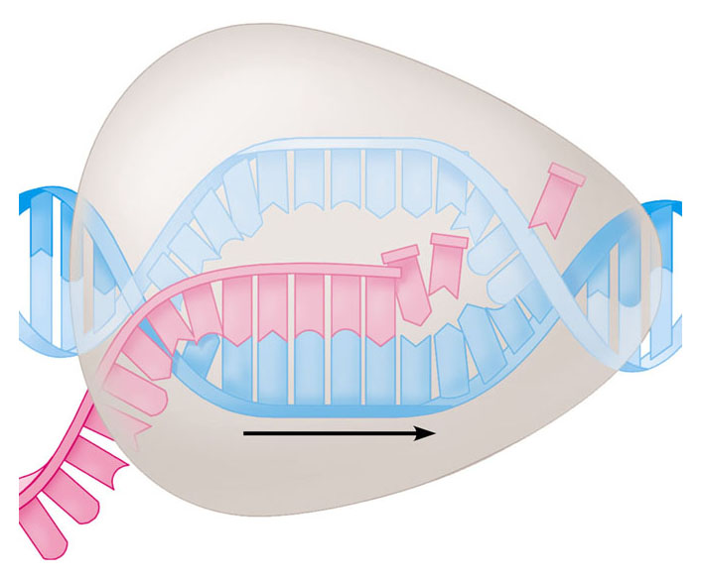
Transcription
RNA polymerase
RNA nucleotides
A
T
C
C
A
A
T
C
T
U
T
G
U
G
C
A
U
C
C
A
A
C
C
G
A
A
T
A
G
G
T
T
Direction of transcription
Template Strand of DNA
Newly made RNA

Slide 11
  In the nucleus, the DNA helix unzips
  And RNA nucleotides line up along one strand of the DNA, following the base pairing rules
  As the single-stranded messenger RNA (mRNA) peels away from the gene
  The DNA strands rejoin

Slide 12
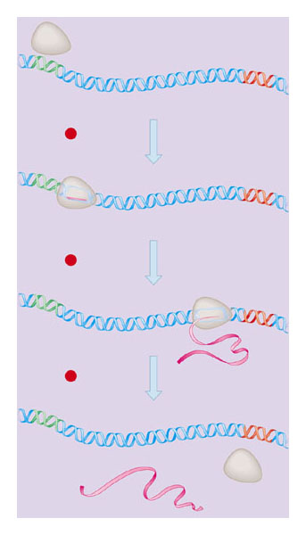
  Steps in transcription of a gene
RNA polymerase
DNA of gene
Promoter
DNA
Terminator
DNA
1 Initiation
2 Elongation
Area shown
In Figure 10.9A
3 Termination
Growing
RNA
Completed RNA
RNA
polymerase

Slide 13
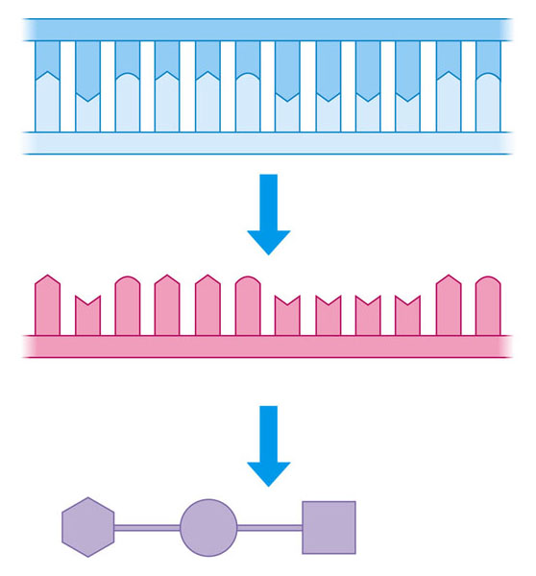
How does DNA/RNA code for protein?
Strand to be transcribed
T
A
C
T
T
C
A
A
A
A
T
C
DNA
A
T
G
A
A
G
T
T
T
T
A
G
Codon -
a sequence of nucleotides that codes for an amino acid
Transcription
A
U
G
A
A
G
U
U
U
U
A
G
RNA
Start
condon
Stop
condon
Translation
Polypeptide
Met
Lys
Phe
STEP III TRANSLATION

Slide 14
How can four nucleotides code for 20 amino acids?
If one nucleotide codes for one amino acid then a maximum of four amino acid could be coded
If two nucleotide code for one amino acid then a maximum of 16 amino acid could be coded
If three nucleotides code for one amino acid then a maximum of 64 codons can be generated, while the number of amino acids are only 20

Slide 15
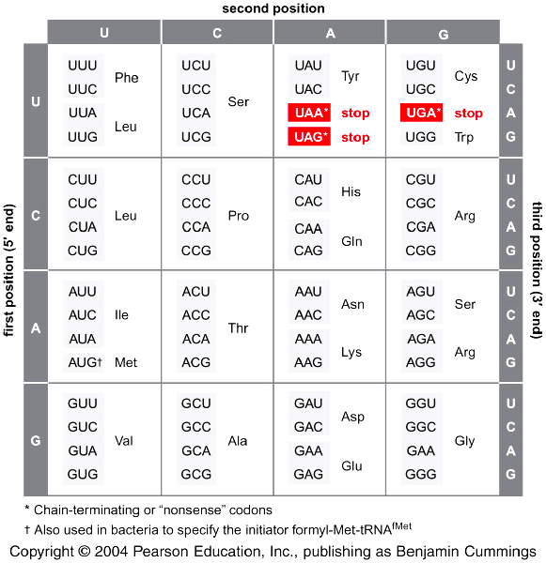
The dictionary of genetic code (64 potential codons)
आनुवान्शिकी कोड की शब्दकोश
5’-→3’
A dictionary offers translation from one language to the other.
Why do we need this translation?
Where does it take place?
Which two languages are being translated in a genetic dictionary?
What is the name of this process?

Slide 16
Hallmarks of genetic code
Triplet : three consecutive nucleotides code of one amino acid
Redundant : meaning not unique (there are more than one codon for most amino acids)
Universal: All organisms bacteria to human use the same genetic codes/dictionary
Comma-less: meaning consecutive codons are readout into an amino acid sequence without gaps

Slide 17
Key players in decoding the genetic message
DNA
Messenger-RNA
Transfer RNA
Amino acid

Slide 18
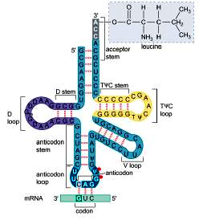
Transfer RNA
Leucine
Anti-codon
Codon

Slide 19
How genetic code is readout in the cell
A C G T A T C G C G T A
DNA
T G C A T A G C G C A T
3’ U G C A U A G C G C A U 5’
mRNA
3’
Amino acid
5’
Anti-Codon
5’
3’
tRNA
C A G
G U C
3’
5’
Codon

Slide 20
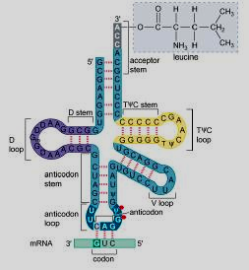
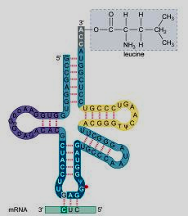
Codon-anticodon pairing of two tRNA Leu molecules
5’-→ 3’
5’-→ 3’
CUG
Codon
CUC
GAC
GAG
Anti- codon
3’-→ 5’
3’-→ 5’

Slide 21
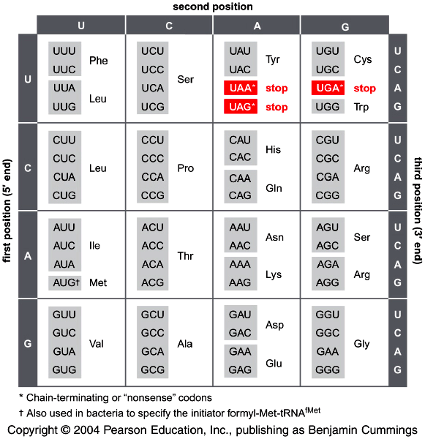
Many amino acids are specified by more than one codon-degeneracy
Codons specifying the same amino acid are called synonyms
Connect the three points about genetic codes:
redundancy, degeneracy and synonymous

Slide 22
Three codons direct chain termination
Three codons, UAA, UAG, and UGA signify chain termination.
They are not read by tRNAs but by proteins called release factors (RF1 and RF2 in bacteria and eRF1 in eukaryotes).

Slide 23
Three Rules
Codons are read in a 5’ to 3’ direction.
Codons are non-overlapping and the message contains no gaps.
The message is translated in a fixed reading frame which is set by the initiation codon.

Slide 24
Meaning and consequences of non-overlapping & comma-less reading of the triplet codons
Let’s consider a metaphor of a normal DNA sequence
FATCATATETHERAT
What is the problem here?
FATATATETHERAT
What is the consequence?

Slide 25
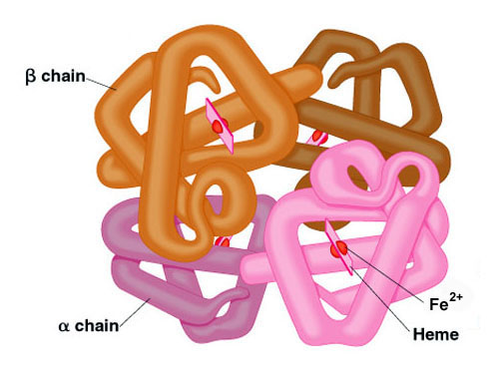
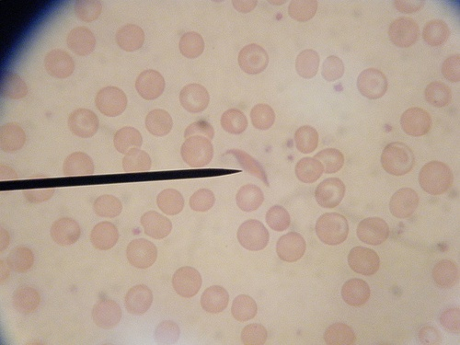
RBC
Structure of Hb
Primary sequence of Hb –first 26 amino acid

Slide 26
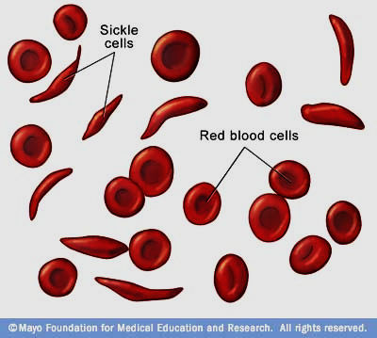
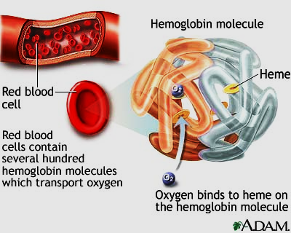
Consider the case of Sickle Cell Anemia?
A serious condition in which red blood cells can become sickle-shaped
Normal red blood cells are smooth and round. They move easily through blood vessels to carry oxygen to all parts of the body.
Sickle-shaped cells don’t move easily through blood. They’re stiff and sticky and tend to form clumps and get stuck in blood vessels.
The clumps of sickle cell block blood flow in the blood vessels that lead to the limbs and organs. Blocked blood vessel can cause pain, serious infection, and organ damage.
While the defect is seen in the protein, sickle cell anemia is produced by changes in gene sequence

Slide 27
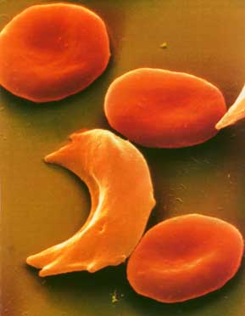
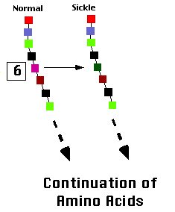
Example Point Mutation
Sickle Cell disease is the result of one nucleotide substitution
Occurs in the hemoglobin Beta- peptide

Slide 28
What could be the nature of the mutation ?
Where has it taken place?
The sixth position in the normal beta chain has glutamic acid, while sickle beta chain has valine.

Slide 29
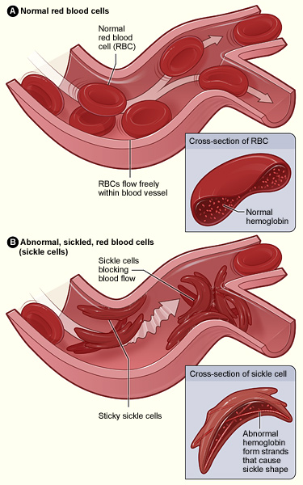
Normal and Sickled Red Blood Cells in Blood Vessels
Figure B shows abnormal, sickled red blood cells clumping and blocking the blood flow in a blood vessel. The inset image shows a cross-section of a sickled red blood cell with abnormal strands of hemoglobin.
Figure A shows normal red blood cells flowing freely in a blood vessel. The inset image shows a cross-section of a normal red blood cell with normal hemoglobin.
Source from http://www.nhlbi.nih.gov/health/dci/Diseases/Sca/SCA_WhatIs.html

Slide 30
Consider a gene that specified the structure of hemoglobin. Arrange the following events in the most likely sequence in which they would take place
a. Anemia is observed
b. The shape of the oxygen binding site is altered
c. An incorrect codon is transcribed into hemoglobin mRNA
d. The ovum (female gamete) receive a high radiation dose
e. An incorrect codon is generated in the DNA of the hemoglobin gene
f. A mother (an X-ray technician) accidentally steps in front of an operating X-ray generator
g. A child dies
h. The oxygen-transport capacity of the body is severely impaired
i. A wrong tRNA is attached
j. Nucleotide pair substitution occurs in the DNA of the gene for hemoglobin

